Slide 1
Intrusion Detection and Prevention Systems A36209
By
D. Jyothi
Department of Cyber Security
CMRCET

Slide 2
CO & PO Mapping
Understanding Intrusion detection System
Architecture and Organization of Intrusion detection Systems
Applications and Tools
Legal Issues and Organizations Standard

Slide 3
Text Books
1. Ali A Ghorbani ,Wei Lu, “ Network Intrusion Detection and Prevention : Concepts and Techniques “, Spinger ,2010(T1)
2. Carl Enrolf ,Eugene Schultz , Jim Mellander , “ Intrusion detection and Prevention “, McGrawHill.2004

Slide 4
Intrusion Detection
Intrusion is an active sequence or related events that deliberately try to cause harm such as rendering a system unusable ,accessing unauthorized information , or manipulating such information .this definition refers to both successful and unsuccessful attempt.

Slide 5
Understanding Intrusion Detection
Security professionals may want to have IDS systems record information about both successful and unsuccessful attempts so that security professionals will have a more comprehensive understanding of the events on their networks. One way this can be done is by placing devices that examine network traffic, called sensors, both in front of the firewall (the unprotected area) and behind the firewall (the protected area) and comparing the information recorded by the two

Slide 6
Understanding Intrusion Detection
An intrusion-detection system (IDS) can be defined as the tools, methods, and resources to help identify, assess, and report unauthorized or unapproved network activity. The intrusion detection part of the name is a bit of a misnomer, as an IDS does not actually detect intrusions it detects activity in traffic that may or may not be an intrusion.

Slide 7
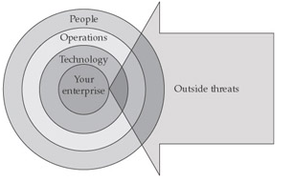

Slide 8
Attack Classification (T1)
Virus: self-replicating program that attach itself to an existing program and infects a system without permission or knowledge
Worm: self-replicating program that propagates through network services on computers without any intervention of users.
Trojan: a piece of program made to perform a certain benign action, but in fact perform different code for malicious purpose.
Buffer overflow: a process that gains control or crashes another process by overwriting the boundary of a fixed length buffer
Denial of service: an attack which prevents intended legitimate users from accessing or using a computer or network resources

Slide 9
Network attack: an attack that crash the users on the network or the network itself through manipulating network protocols, ranging from the data-link layer to the application layer
Physical attack: an attack that attempts to damage physical components of a network or computer.
Password attack: an attack that aims to gain a password and is usually indicated by a series of failed logins within a short period of time
Information gathering attack: an attack that gathers information or finds known vulnerabilities by scanning or probing existing computer networks.

Slide 10
Layer | Function | Protocol
Application (user interface | This layer is used for applications, such as HTTP, specifically written to run over the network and allows accesses to network services. It handles issues like network transparency, resource allocation, and problem partitioning. The application layer is concerned with the user's view of the network, like formatting. In addition, this layer allows access to services that support applications and handle network access, flow, and recovery | DNS, FTP, TFTP(Trivial File transfer Protocol), BOOTP(Bootstrap Protocol), SNMP(simple network management protocol), RLOGIN, SMTP(Simple mail transfer protocol), MIME(Multipurpose internet mail extension ), NFS(Network File system), FINGER, TELNET, APPC, AFP(Apple Talk Filing Protocol),

Slide 11
Presentation (translation) | The presentation layer helps to translate between the application and the network formats. This is also where protocol conversion takes place | Named Pipes, Mail Slots, RPC(Remote Procedure call), NCP(Network control program), SMB(Server message Block)

Slide 12
Session | The session layer helps to establish, maintain, and end sessions across the network. | NetBios

Slide 13
Transport (packets; flow control and error-handling | The transport layer manages the flow control of data between parties across the network. | TCP, ARP(Address Resolution Protocol), RARP(reverse address resolution protocol), SPX(sequenced packet Exchange), NWLink(Novell’s IPX\SPX ), ATP(Autonomous Transport Protocol), NetBEUI(NetBIOS Extended User Interface)

Slide 14
Network (addressing; routing | The network layer translates logical network addresses and names to their physical addresses and is responsible for addressing and managing network problems such as packet switching, data congestion, and routing | IP, ARP, RARP(Reverse Address Resolution Protocol), ICMP, RIP, OSFP(Open shortest path first), IGMP(Internet Group Management Protocol), IPX(Internetwork Packet Exchange), NWLink, OSI, DDP(Data Gram Delivery), DECnet(suite of network protocols created by Digital Equipment Corporation)

Slide 15
Physical (hardware; raw bit stream) | The physical layer transmits the raw bit stream over the physical cable or airwaves (when dealing with wireless). It defines cables, cards, and other physical aspects | IEEE 802, IEEE 802.2, ISO 2110, ISDN(Integrated Services Digital Network)

Slide 16
Types of IDS Systems
NIDS | HIDS
Broad in scope (watches all network activities | Narrow in scope
Easier setup | More complex setup
Better for detecting attacks from the outside | Better for detecting attacks from the inside
Less expensive to implement | More expensive to implement
Detection is based on what can be recorded on the entire network | Detection is based on what any single host can record
Examines packet headers | Does not see packet header
Near real-time response | Usually only responds after a suspicious log entry has been made
OS-independent | OS-specific
Detects network attacks as payload is analyzed | Detects local attacks before they hit the network
Detects unsuccessful attack attempts | Verifies success or failure of attacks

Slide 17
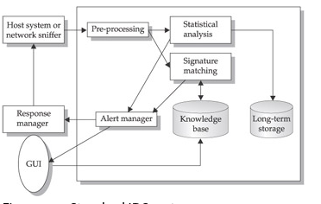
Standard IDS System

Slide 18
IPS
An IPS will typically consist of four main components:
Traffic normalizer
Service scanner
Detection engine
Traffic shaper

Slide 19
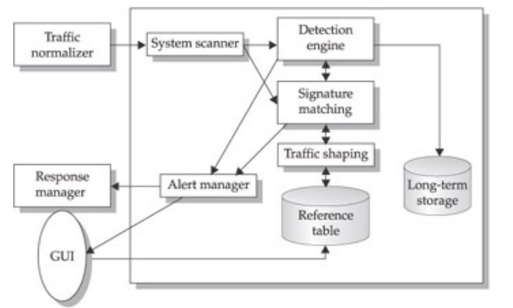
Standard IPS System

Slide 20
IDS vs. IPS
IDS | IPS
Installed on network segments (NIDS) and on hosts (HIDS) | Installed on network segments (NIPS) and on hosts (HIPS)
Sits on network passively | Sits inline
Cannot parse encrypted traffic | Better at protecting applications
Central management control | Central management control
Better at detecting hacking attacks | Ideal for blocking web defacement
Alerting product (reactive) | Blocking product (proactive)

Slide 21
IDS & IPS Analysis Schemes (T2)
Analysis : Organization of the constituent parts of data and their interrelationship to identify any anomalous activity of interest Real time analysis is done on the live data travelling from host to network or host . Analysis can also be performed on the near real data.

Slide 22
Fundamental goal of intrusion detection and prevention is to provide the information security . This involves
Creating records of relevant activity for follow up
Determine flaws in the network by detecting specific activities
Record unauthorized activity for use in forensic or criminal prosecution attacks
Act as a deterrent to malicious activity
Increase accountability by linking activities one individual across systems

Slide 23
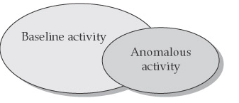

Slide 24
The Anatomy of Intrusion Analysis
The Anatomy of Intrusion Analysis
Preprocessing
Analysis
Response
Refinement

Slide 25
Preprocessing
Is a key function once data are collected from an IDS or IPS sensor? Data are organized in some fashion for classification. The preprocessing will help determine the format the data are put into, which is usually some canonical format or cloud be a structure database. Once the data are formatted, they are broken down further into classifications.

Slide 26
Statistical profile based on different algorithms in which the user behavior is baselined over time and any behavior that falls outside of the classification is flagged as an anomaly after completing the classification process. The data is concatenated and put into a defined version or detection template of some object by replacing variables with values. These detection templates populate
The knowledgebase which are stored in the core analysis engine
Detection of the modification of system log files
Detection of unexpected privilege escalation

Slide 27
Detection of Backdoor Netbus
Detection of Backdoor SubSeven
ORACLE grant attempt
RPC mounted UDP export request
Once the preprocessing is complete .The analysis stage begins . The data record is compared to the knowledge base, and the data record will either be logged as an intrusion event or it will be dropped

Slide 28
Response :
IDP: limited prevention abilities ,Information is passive ,alert is after the fact . Once the information has been logged as an intrusion , a response can be initiated .
IPS: Sensor is inline and it provides real time prevention through an automated response .

Slide 29
Refinement Phase
Fine tuning of IDS and IPS system can be done based on previous usage and detection intrusion . This gives the security professional a chance to reduce false positives levels and to have a more accurate security tool. Eg Cisco Threat Response (CTR)

Slide 30
Rule based Detection (Misuse Detection )
Catching and identifying anomalies is what we call anomaly or outlier detection. For example, if large sums of money are spent one after another within one day and it is not your typical behavior, a bank can block your card. They will see an unusual pattern in your daily transactions
Collect data about intrusions, vulnerability ,and attacks , and put them into a classification scheme or pattern descriptor . From the classification scheme behavior model is built and put into a common format
Signature Name : The given name of a signature
Signature ID : A unique ID for the signature
Signature Description : Description of the signature and what it does
Possible False Positive Description An explanation of any “false positives “ that may appears to be an exploit but are actually normal activity
Related vulnerability Information This field has any related vulnerability information
User notes This field allows a security professional to add specific notes related to their network

Slide 31
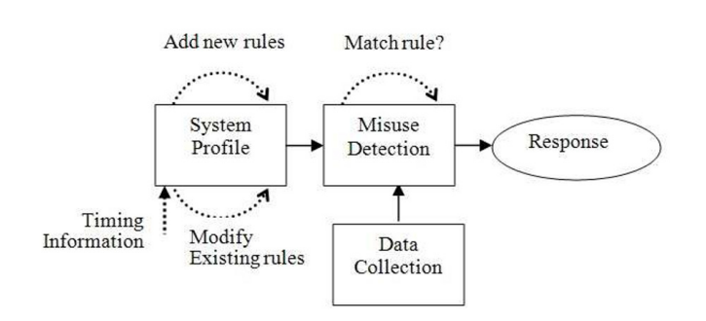
Detection Approaches (t1)
Misuse Detection

Slide 32
Analysis The event data are formatted and compared against the knowledge base by using a pattern matching analysis engine. The analysis engine looks for defined patterns that are known as attacks.
Response If the event matches the pattern of an attack ,the analysis engine sends an alert . If the event is a partial match, the next event is examined .
Refinement of pattern matching analysis comes down to updating signatures because an IDS is only as good as its latest signature update . This is one of the drawbacks of pattern matching analysis. Most IDS allow automatic and manual updating of attack signatures

Slide 33
Profile based Detection (Anomaly Detection )
Creates a profile system that flags any event that strays from a normal pattern and passes this information on to output routines.
One key distinction between anomaly detection and other analysis schemes is that anomaly schemes not only define activities that are not allowed , but also activities that are allowed. Anomaly detection is typically used for its ability to collect statistical behavior and characteristic behavior .
Eg: “This server’s UDP traffic never exceeds 25 percent of capacity” describes a statistical behavior “User Stan321 does not normally FTP files outside of the company “ describes a character behavior.
large sums of money are spent one after another within one day and it is not your typical behavior, a bank can block your card. They will see an unusual pattern in your daily transactions.

Slide 34
Target Monitoring
Target Monitoring systems will report whether certain target objects have been changed or modified . This is usually done through a cryptographic algorithm that computes a crypto cheksum for each target file. The IDS reports any changes such as a file modifications or program logon ,Which would cause changes in crypto checksums
Tirewire software will perform monitoring using crypto checksum by providing instant notifications of changes to configuration files and enabling automatic restoration. The main advantages of this approach is that you do not have to continuously monitor the target files .

Slide 35
Stealth Probes
Stealth probes correlate data to try to detect attacks made over a long period of time often referred to as “low as slow” attacks . Data are collected from variety of sources , and it is characterized and sampled to discover any correlating attacks . This techniques is also referred to as wide area correlation , and it is typically a combination or hybrid approach that uses other detection methods to try and uncover malicious behavior .

Slide 36
Heuristics
The term heuristics refer to artificial intelligence (AI) . In theory an IDS will identify anomalies to detect an intrusion , and it will then learn over time what an be considered normal. To use heuristics , an AI scripting language can apply analytics to the incoming data.
Heuristics still leave a lot to be desired at this stage, but development is progressing . What is needed is a pattern matching language that can use programming constructs to learn and identify malicious activity more accurately

Slide 37
Hybrid Approach
We have examined the fundamental analysis shcemes. You will find that there is much debate on which is considered the best approach . In actuality ,they all have their merits and drawbacks .but when they are used together they can offer a more robust security system. Products that use a hybrid approach typically perform better especially against complex attacks .

Slide 38
Example IDS Rules
We have looked at the theory of IDS patterns and analysis schemes . It seems appropriate at this point to examine few IDS rules to illustrate those concepts
Open source IDS Snort detects whether the NetBUs backdoor is running on a system
Alert tcp $HOME_NET 12345:12346 -> $EXTERNAL_NET any (msg: “BACKDOOR netbus active”; flow: from:from_server ,established ; content :”NetBus”;
Reference:arachnids,401; classtype:misc-activity; sid:109; rev:4;)

Slide 39
From the above rule ,we can see that Snort will send alert if a TCP packet on ports 12345-12346 come through. If that happens ,Snort sends the message of “BACKDOOR netbus active “ and the message is given a class type of miscellaneous activity and a signature ID of 109.
The following Snort IDS signature detect a DNS zone transfer request :
Alert udp $EXTERNAL_NET any -> $ HOME_NET 53 (msg : “DNS zone transfer UDP” ; content : “!00 00 FC! “, offset : 14 ;
Reference:cve ,CAN-1999-0532;
Reference:arachnids ,212; classtype:attempted-recon; sid:1948;
Rev:1;)
From this signature we can see that Snort sends an alert if a UDP packet on port 53 comes through. Snort sends the message”DNS zone transfer UDP” with a class type of attempted reconnaissance and a signature ID of 1948.

Slide 40
Attacks
compromise the Integrity , Confidentiality or Availability of computer network systems
annoying email directed at an individual to intrusion attacks
Viruses Attached to E-Mails
system to collect information, Internet worms , unauthorized usage of a system
denial-of-service by abusing a feature of a system
exploiting a bug in software to modify system data
Social Engineering

Slide 41
Masquerading
Vulnerability
Abuse of Functionality
opening hundreds of telnet connections to other computers.
VERDICT (Validation Exposure Randomness Deallocation Improper Conditions Taxonomy)

Slide 42
Probes
The goal of this information gathering is to find out about computer and services that are present in a network as well as to detect the possibility of attack based on known vulnerabilities

Slide 43
IPSweep and PortSweep
The IPSweep and PortSweep attack determine the running host and its service types, and then the collected information can be used by attackers in staging attacks and searching for vulnerable computers.

Slide 44
NMap
NMap is a free and open source utility that mainly performs IP scans, port scans, firewall scans and OS fingerprinting using raw IP packets directed at victim computers

Slide 45
MScan
MScan uses DNS zone transfers and brute force scanning over the whole domains and complete ranges of IP addresses to discover active computers and probe them for well known vulnerabilities in various network services such as statd, NFS.

Slide 46
SAINT Security Administrator’s Integrated Network Tool
SAINT is the acronym for Security Administrator’s Integrated Network Tool. It gathers a large amount of information from networking services, such as finger, ftp, telnet, tftp, NIS, NFS, rexd, statd, and some other services.
performs port scans on several well known TCP ports such as HTTP, FTP, Telnet, SMTP, UUCP, and NNTP, and UDP ports, such as DNS.

Slide 47
Satan
SAINT, Satan supports three levels of scanning: light, normal, and heavy. An example for the list of vulnerabilities scanning in the heavy mode is as follows,
• NFS export to unprivileged programs.
• NFS export via port mapper.
• NIS password file access.
• REXD access. • TFTP file access.
• Remote shell access. • Unrestricted NFS export.
• Unrestricted X Server access.
• Write-able FTP home directory. • Several Sendmail vulnerabilities. • Several FTP vulnerabilities.

Slide 48
Privilege Escalation Attacks
Privilege escalation attacks are those attacks in which the intruder exploits a bug in a software application to gain access to resource that normally would have been protected from an application or user, resulting in an escalation or leverage of current privilege levels to carry out a malicious action with more privileges than intended by the application developer and system administrator
1. Vertical privilege escalation or User to Super-user
2. Horizontal privilege escalation or Non-user to User

Slide 49
Buffer Overflow Attacks
Microsoft Outlook and Outlook Express in 2000. Due to a programming flaw made by Microsoft, attackers are able to execute any type of code they desired on the victim computers

Slide 50
Misconfiguration Attacks
misconfiguration attacks are Dictionary and FTPWrite. In the Dictionary (also known as brute-force) attack, an attacker knows about a user-name and makes repeated guessing attempts for the password from a list of possible passwords.
FTP-Write attack, exploits the anonymous account that is a common login mode provided by FTP services. If the anonymous FTP root directory or its subdirectories are owned by the FTP account or are in the same group as the FTP account and they are not write protected,

Slide 51
Man-in-the-Middle Attacks
the attacker must be able to intercept all messages going between the two victims, inject new ones and impersonate each endpoint to the satisfaction of the other.

Slide 52
Social Engineering Attacks
Another popular methods conducted by social engineering attacks are through phone and online communications. The attackers can simply make a call to Call Centers or Help Desks and pretend that they are calling from inside the credit union. By playing tricks on the phone system or operator, a smart attacker can imitate someone in a position of authority or relevance and gradually pull information out of the user or the smart attacker may masquerade as a legitimate user who needs a password reset.

Slide 53
Denial of Service (DoS) and Distributed Denial of Service (DDoS) Attacks
Distributed denial of service (DDoS) attacks are developed in a distributed fashion. In real networks, the intended victims of DoS attacks are usually powerful servers with fast network connections.

Slide 54
Detection Approaches for DoS and DDoS Attacks
Snort [63] apply signatures of well known DoS and DDoS attacks for identify them
Bro [57], apply such as a way to detect DoS and DDoS attacks based on the (statistical) changes in the normal behavior of applications and protocols.
An outlier detection algorithm based on Gaussian mixture model (GMM) is then used to analyze the value of IPTraffic and make intrusion decisions according to the outlier detection result.
Gil et al. propose a Multi-Level Tree for Online Packet Statistics, called MULTOPS, for identifying attacks by exploiting the correlation of incoming and outgoing packet rates at different levels of subnet prefix aggregation.

Slide 55
Prevention and Response for DoS and DDoS Attacks
RPF (reverse path forwarding) check
Mirkovic et al. propose in [51] a system called D-WARD located at the source network router (either LAN or border router), which can autonomously detect and delete DDoS flows originating at that network.
Mahajan et al. propose an aggregate congestion control and a pushback technique to identify and throttle attack flows. Pushback plays a role on reacting aggregate upstream until the congestion actually happens. Moreover, the detection of traffic aggregation is only based on the destination IP addresses

Slide 56
Examples of DoS and DDoS Attacks
TCP-SYN Flood
ICMP/UDP Flood Attack
Ping of Death
Smurf
Process Table
UDPStorm
Syslogd
Mailbomb
Apache2

Slide 57
Worms Attacks
The Morris worm is one of the first computer worms distributed via the Internet [70]. The basic idea behind Morris worm and the recent frequently launched worm attacks on the Internet is to target vulnerabilities in daemon processes of important network services through exploiting the static buffer overflow.

Slide 58
Examples of Well Known Worm Attacks
Blaster The worm exploits the buffer overflow vulnerability in the DCOM RPC service and is coded to start a SYN flood port 80 of website windowsupdate.com.

Slide 59
Nachi
exploits a vulnerability in the Microsoft RPC service. Different with the Blaster worm, Nachi helps the customer downloading and installing security patches from Microsoft website
August 2003, the outbreak of Nachi infected the ATM machines of two main financial institutions, triggered banks’ IDSs to disconnect many ATMs from the network. The after effect is just equivalent to a successful DoS attack.

Slide 60
Slammer
The Slammer worm started in January 2003 infected 75000 victims in just 10 minutes and is considered as one of the fast-propagating Internet worms. It exploits two buffer overflow flaws in Microsoft SQL Server and then replicates itself by sending packets to randomly-generated IP addresses seeking more probable victim hosts.

Slide 61
Routing Attacks
Routing attacks exploit flaws and vulnerabilities in the design and implementation of routers. A common routing attack is a protocol specific break-in that targets operations of routing information exchange. Most sophisticated attacks or substantial DoS attacks are originally based on the routing attacks against the IP routing infrastructure
OSPF is perhaps the most widely used link-state hierarchical Interior Gateway Protocol (IGP) routing algorithm in which the shortest path tree is calculated using a method based on Dijkstra’s algorithm. A link state database is constructed to maintain the tree image of network topology in each router and identical copies of the database will be periodically updated by flooding on all routers in each OSPF aware area

Slide 62
BGP is a core routing protocol of the Internet and works by maintaining a table of IP networks that designate network reachability both inside an Autonomous System (AS, is a collection of IP networks under control of a single entity) as well as outside an AS. BGP is a path vector protocol and does not use traditional IGP metrics.

Slide 63
OSPF Attacks
Seq++
Maximum Age
Maximum Sequence Number

Slide 64
BGP Attacks
There are 7 common mechanisms that BGP attackers usually like to use, namely false updates and prefix hijacking, de-aggregation, contradictory advertisements, update modifications, advertent link flapping, instability and congestion-induced BGP session failures

Slide 65
Pattern Matching
network based intrusion detection systems in which attack patterns are modeled, matched and identified based on the packet head, packet content or both.
pattern matching more expensive in terms of the computational cost
Abbes et al. propose a method combining a novel protocol analysis approach with traditional pattern matching to improve the performance of pattern matching when looking for attack signatures [1].
The model attempts to emulate a traffic mix of different applications, reflecting the characteristics of each application and the way these applications interact with the system.

Slide 66
Rule-based Techniques
Expert systems encode intrusive scenarios as a set of rules, which are matched against audit or network traffic data. Any deviation in the rule matching process is reported as an intrusion. Examples of rule-based systems include MIDAS (Multics Intrusion Detection and Alerting System) [65], IDES (Intrusion Detection Expert System) [53], and NIDES (Next-generation Intrusion Detection Expert System) [3, 4]

Slide 67
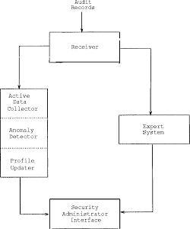

Slide 68
MIDAS
MIDAS was designed and developed by the National Computer Security Center (NCSC) to monitor intrusions for NCSC’s networked mainframe, Dockmaster. It uses and analyzes audit log data by combining the expert system technology with statistical analysis.
combining the expert system technology with statistical analysis.
MIDAS uses the Production Based Expert System Toolset

Slide 69
IDES
mathematical codification of intrusion detection mechanisms
IDES uses P-BEST to describe its rule base consisting of two types of rules: generic rules and specific rules. Generic rules can be used for different target systems and specific rules are strictly dependent on the operating system and the corresponding implementation. IDES architecture consists of three main components, namely audit database, profiles database and the system security officer (SSO) user interface

Slide 70
NIDES(Next generation intrusion detection Expert System)
NIDES is a hybrid intrusion detection system consisting of a signature-based expert system component as well as a detection component based on statistical approaches
The NIDES system is highly modularized with well-defined interfaces between components. Compared with the IDES, NIDES has higher detection rate since it includes two complementary detection components: intrusions missed by one component maybe caught by the other one.

Slide 71
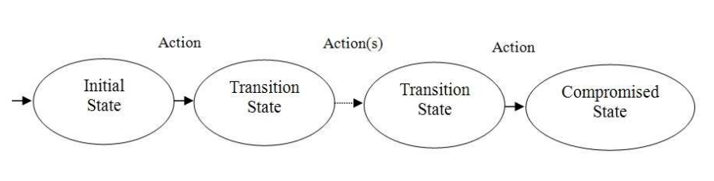
State-based Techniques
state-based techniques, activities contributing to intrusion scenarios are defined as transitions between system states, and thus intrusion scenarios are defined in the form of state transition diagrams.

Slide 72
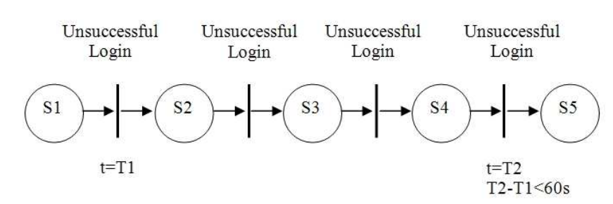
Colored Petri-nets
the transition from states S1 to S2 occurs when there is a token in S1; this stands for an unsuccessful login attempt. The time of first unsuccessful login attempt is saved in the token variable T1. The transition from S4 to S5 happens if there is a token in S4. The time difference between this and the first unsuccessful login attempt should be more than one minute, otherwise the system state is transferred to the final state S5, in which an alarm will be generated

Slide 73
Techniques based on Data Mining
Classification algorithms such as decision tree generate classifiers by learning based on a sufficient amount of normal or abnormal audit data. New audit data are labeled as either normal or abnormal according to the classifier. Link analysis determines the relation between fields in the audit database records and normal profiles are usually derived from these relations. Sequence analysis is used to find sequential patterns in audit data and embed these patterns into intrusion detection models.

Slide 74
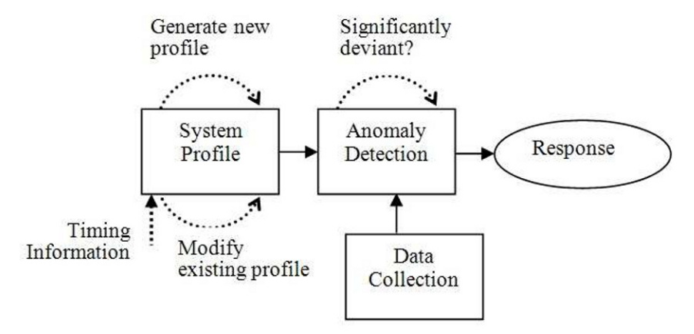
Anomaly Detection

Slide 75
Many anomaly detection techniques have been proposed in the literature. These range from advanced statistical models to artificial intelligence and biological models based on human immune system

Slide 76
Advanced Statistical Models
consists of eight components: subjects, objects, audit records, statistical metrics, statistical models, profiles and profile templates, anomaly records and activity rules

Slide 77
Haystack
Statistical techniques are used to detect anomalous activities. A set of features such as the amount of I/O, CPU utilization, number of file accesses are observed and then the normal range of values for these features are defined. Activities falling outside these ranges are reported as intrusions.

Slide 78
NIDES
NIDES includes a statistical anomaly detector as well. The audit information collected consist of user names, names of files accessed, elapsed user CPU time, total number of files opened, number of pages read from secondary storage, identities of machines onto which user has logged, etc. Statistics are computed from the collected audit information

Slide 79
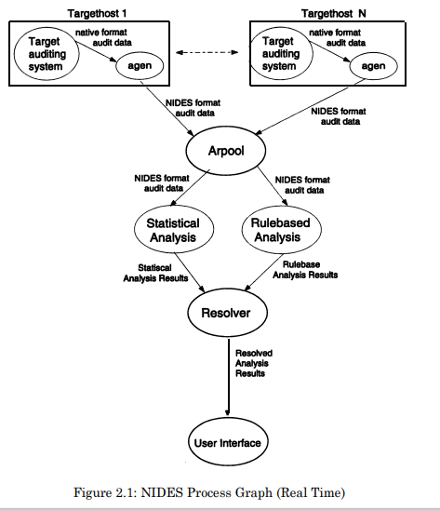

Slide 80
EMERALD
The Event Monitoring Enabling Responses to Anomalous Live Disturbances (EMERALD) is an environment for anomaly and misuse detection. It consists of a signature analysis component and a statistical profile-based anomaly detection component.

Slide 81
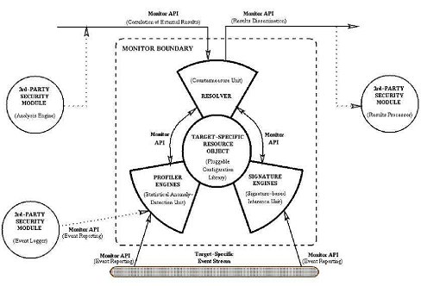

Slide 82
Network Security Monitor (NSM)
All network traffic passing through a broadcast LAN are observed by NSM.
TCP/IP, telnet, SMTP
Host vectors and connection vectors are the main input to the expert system in NSM

Slide 83
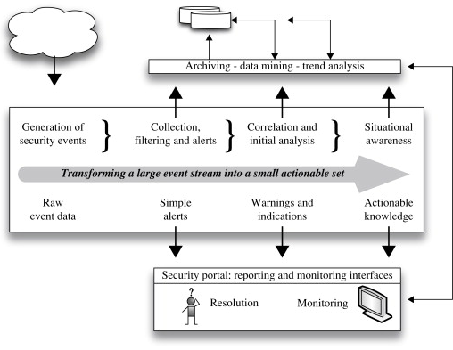

Slide 84
Time-based Inductive Machine (TIM)
Time-based Inductive Machine (TIM) models user’s normal behavior patterns by dynamically generating activity rules using inductive generalization
predict the next event from a given sequence of events

Slide 85
NADIR
NADIR (Network Anomaly Detection and Intrusion Reporter) was developed at Los Alamos National Laboratory to monitor their internal computer networks
It collects audit information from three different kinds of service nodes, namely network security controller, common file system and security assurance machine

Slide 86
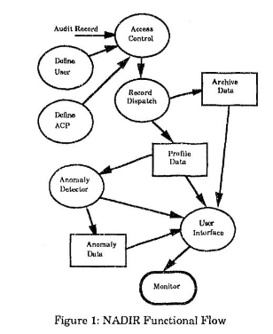

Slide 87
Biological Models
In the human systems, T cells are created in the thymus and then a censoring process happens. If T cells bind with proteins or peptides (sub-units of proteins), then they will be transferred because they bind with themselves (self). Some T cells that do not bind with proteins are released to monitor the foreign material (non self) of the body. A hypothesis is that those T cells that bind with foreign materials will then be removed from human systems.
In the human systems, T cells are created in the thymus and then a censoring process happens. If T cells bind with proteins or peptides (sub-units of proteins), then they will be transferred because they bind with themselves (self). Some T cells that do not bind with proteins are released to monitor the foreign material (nonself) of the body. A hypothesis is that those T cells that bind with foreign materials will then be removed from human systems.

Slide 88
Learning Models
two categories: unsupervised and supervised.
unsupervised anomaly detection attempts to detect intrusions without using any prior knowledge of attacks or normal instances
Unsupervised anomaly detection addresses these issues by allowing training based on unlabeled data sets and thus facilitating online learning and improving detection accuracy.

Slide 89
Supervised Anomaly Detection
Using Neural Network
The first component is an expert system, which monitors audit trails for known intrusion signatures. The second component uses neural network to learn user behaviors; it then fires an alarm when there is a deviation between current behaviors and learnt behaviors. The use of neural network in Hyper view assumes that the audit data consist of multivariate time series, since user behavior exhibits a dynamic process executing an ordered series of events.

Slide 90
Specification-based Detection (T1)
Specification-based detection approaches are neither misuse based, nor anomaly based
specification-based systems the experts’ knowledge determines the operating limits (threshold) of a system. Once the correct (or allowed) system behavior is specified. The events deviating from the specification would generate an alert
An execution sequence performed by the subject that violates the specification of programs will be considered as an attack.

Slide 91
Theoretical Foundation of Detection
machine learning techniques for intrusion detection is to automatically build the model based on the training data set.
The attributes can be of different types such as categorical or continuous.
The labels associated with data instances are usually in the form of binary values, i.e. normal and anomalous.
Supervised Anomaly Detection:
Semi-supervised Anomaly Detection:
Unsupervised Anomaly Detection:

Slide 92
Supervised Anomaly Detection:
classification methods need a labeled training set containing both normal and anomalous samples to build the predictive model.
As examples of supervised learning methods we can name Neural Networks, Support Vector Machines (SVM), k-Nearest Neighbors, Bayesian Networks, and Decision Trees.
supervised methods are very dependent on the labeled training data which is usually error-prone, time consuming and costly,

Slide 93
Semi-supervised Anomaly Detection:
Semi-supervised learning falls between unsupervised learning (without any labeled training data) and supervised learning (with completely labeled training data).
any test instance that does not fall within the learned boundary is declared as anomalous.
impossible to obtain a training set which covers every possible anomalous behavior.

Slide 94
Unsupervised Anomaly Detection:
unsupervised techniques do not require training data. Instead, this approach is based on two basic assumptions . First, it assumes that the majority of the network connections represent normal traffic and that only a very small percentage of the traffic is malicious . Second, it is expected that malicious traffic is statistically different from normal traffic.
anomaly detection is one of the possible avenues of being able to build large, reliable anomaly detection systems without the need for extensive and costly manual labeling of instances.

Slide 95
Scores
Scores: in this technique, anomaly detectors will assign a numeric score to each instance which indicates how likely it is that the test instance is anomaly. The advantage of this technique is that the analyst can rank the malicious activities, set a threshold to cut off the anomalies.
Eg: Bayesian networks such as Naive Bayes

Slide 96
Binary Labels:
some of the anomaly detection techniques such as Decision Trees label the test instances as either anomalous or normal.

Slide 97
Labels:
Anomaly detection techniques in this category assign a label to each test instance. In this approach, usually there is one label for normal traffic, normal. For the anomalies, however, there are plenty of labels showing the types of anomalies. For example, some methods apply the labels normal, DoS, Probe, U2R, and R2L.

Slide 98
Fuzzy Logic
The 'Fuzzy' word means the things that are not clear or are vague. Sometimes, we cannot decide in real life that the given problem or statement is either true or false. At that time, this concept provides many values between the true and false and gives the flexibility to find the best solution to that problem.
Fuzzy logic contains the multiple logical values and these values are the truth values of a variable or problem between 0 and 1. This concept was introduced by Lofti Zadeh in 1965 based on the Fuzzy Set Theory. This concept provides the possibilities which are not given by computers, but similar to the range of possibilities generated by humans.

Slide 99

Membership Function
A fuzzy set is a collection of values which exist between 0 and 1. Fuzzy sets are denoted or represented by the tilde (~) character. In the fuzzy set, the partial membership also exists. This theory released as an extension of classical set theory.
This theory is denoted mathematically as A fuzzy set (Ã) is a pair of U and M, where U is the Universe of discourse and M is the membership function which takes on values in the interval [ 0, 1 ]. The universe of discourse (U) is also denoted by Ω or X.

Slide 100
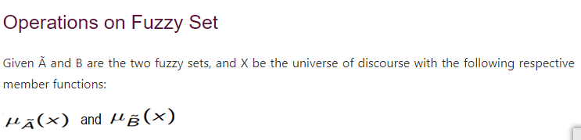

Slide 101
Fuzzy Logic in Anomaly Detection
There are three fuzzy characteristics used in this work: COUNT, UNIQUENESS and VARIANCE. The implemented fuzzy inference engine uses five fuzzy sets for each data element (LOW, MEDIUM-LOW, MEDIUM, MEDIUM-HIGH and HIGH) and appropriate fuzzy rules to detect the intrusion.

Slide 102
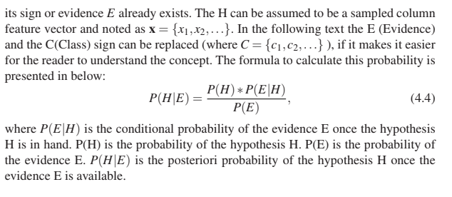
Bayes Theory

Slide 103
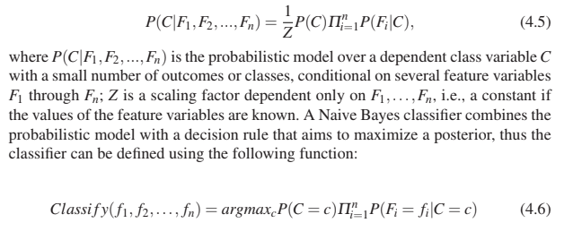
Naive Bayes Classifier

Slide 104
Artificial Neural Networks
Artificial neural networks (ANNs) are adaptive parallel distributed information processing models that consists of: (a) a set of simple processing units (nodes, neurons), (b) a set of synapses (connection weights), (c) the network architecture (pattern of connectivity), and (d) a learning process used to train the network.

Slide 105
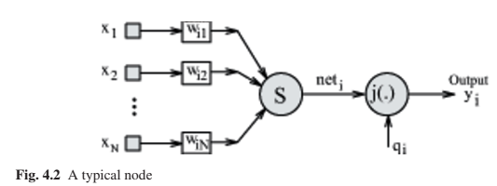
Processing Elements
They can possess local memory in order to carry out localized information processing operations.

Slide 106
There are three types of nodes: (a) input nodes which receive data from out side; (b) hidden nodes whose input and output signals remain within the network itself; and (c) output nodes which send data out of the network. Figure 4.2 shows a schematic of a typical node.

Slide 107
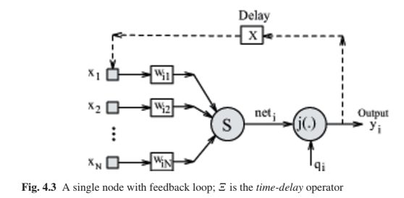

Slide 108
Every node i has also an extra input, x0, which is set to a fixed value θi with connection weight label wi0, and is referred to as a node’s bias. A static node simply applies a squashing function, φ, on the weighted sum of its inputs, as where N is the number of inputs (i.e., the output signals of the units having connections to the ith unit), and neti(n) is the overall excitation of unit i at time n and we will refer to it as net input.

Slide 109
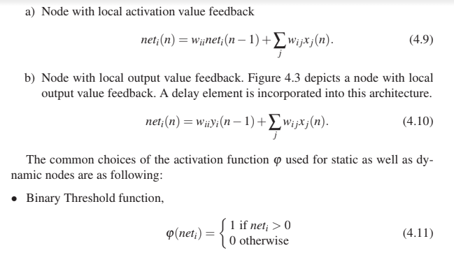

Slide 110
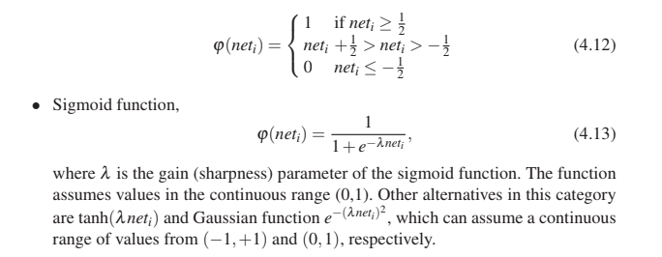

Slide 111
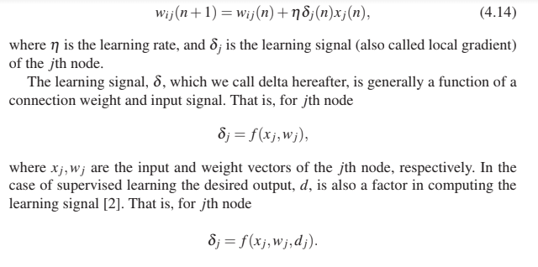
Connections
The pattern of connectivity represents what the network is representing at any time. A connection weight, wi j, is modified as follows

Slide 112
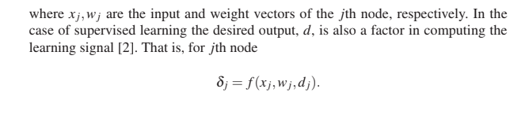

Slide 113
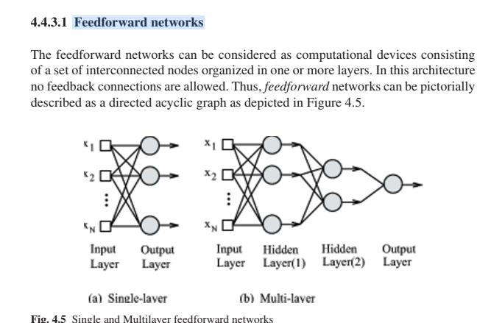
Feed forward networks

Slide 114
Recurrent networks
whereas recurrent networks are suitable for spatiotemporal information processing [33]. The dynamic properties of recurrent neural networks make them universal approximators of dynamical systems. There are two types of recurrent neural networks: discrete time recurrent neural networks and continuous time ones. Figure 4.6(a) illustrates a recurrent network without hidden nodes and without self-feedback loops. Note that the time delay
operator causes the recurrent networks of nonlinear nodes to perform onlinear dynamic behavior.

Slide 115
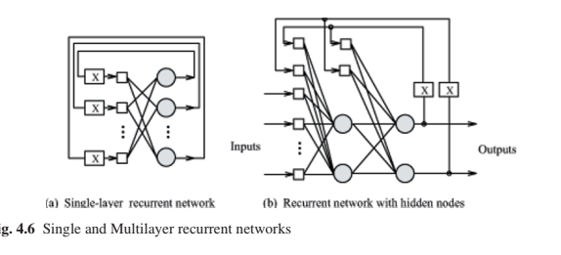

Slide 116
Learning Process
Supervised learning in which the learning process is supervised by a teacher who presents input vectors (patterns) with matching (desired) outputs. In supervised learning, nodes are considered as adaptive elements. Their connection strengths are adjusted depending on the input signals they receive, their actual output values, and the associated teachers responses. A variation to this is the reinforcement learning algorithm in which a quantitative measure of comparison between actual output and the desired output of a network is used to train the network.

Slide 117
Unsupervised learning wherein the learning is to discover significant patterns or features in the input data without supervision. There is no teacher to provide the desired output signals nor are there any reward or punishment to be used in the process of learning.

Slide 118
Artificial Neural Networks in Anomaly Detection
Multilayer perceptron (MLP)
Self-Organizing Map (SOM)

Slide 119
Support Vector Machine (SVM)
The basic idea of SVM is to increase dimensionality of the samples so that they can be separable. Therefore, despite the usual trend toward dimensionality reduction, in SVM the dimensionality is actually increased. The idea is to find a hyper-plane to place samples from the same class inside it (in the high dimensional space this may look like a hyper-volume).

Slide 120
Support Vector Machine (SVM)
SVM is to increase dimensionality of the samples so that they can
be separable.
Assume the original samples are in the x space and they are transformed (dimensionality enlargement) to the y space, where y = φ(x). In addition,suppose we have some hyperplane which separates the positive from the negative examples (a“separating hyperplane”) provided by:
wT x+b = 0

Slide 121
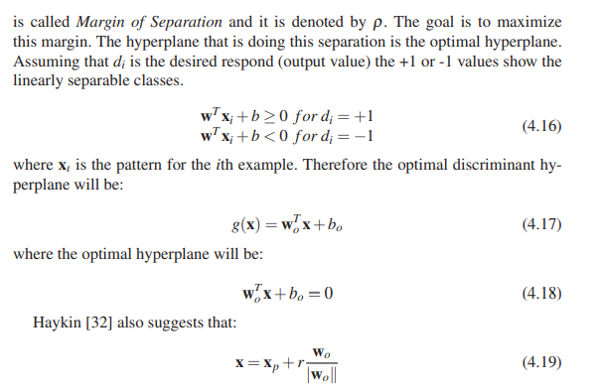

Slide 122
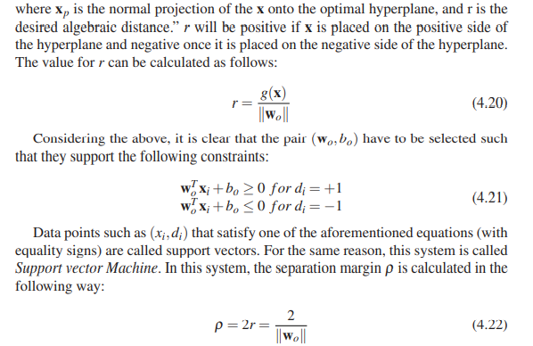

Slide 123
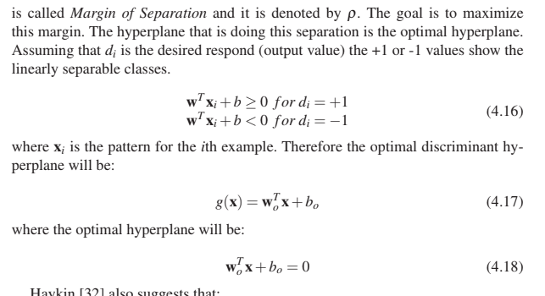

Slide 124
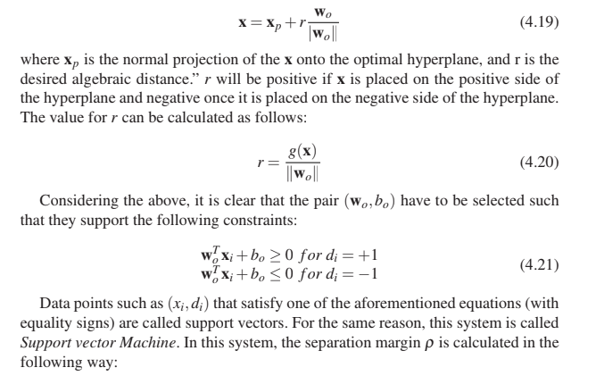

Slide 125
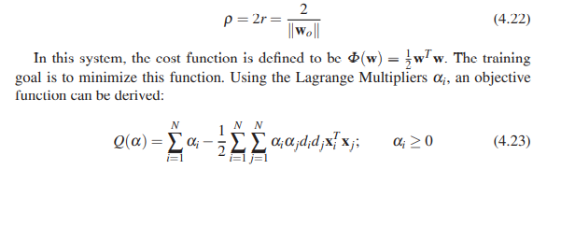

Slide 126
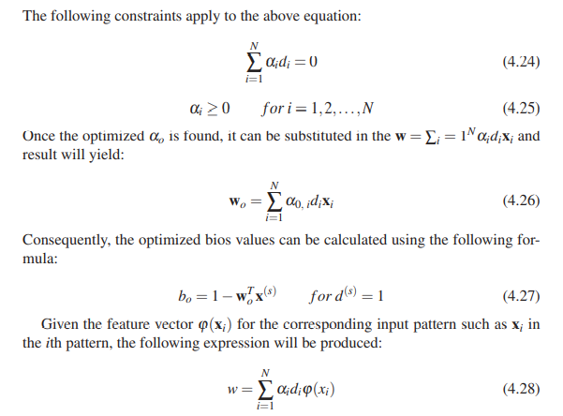

Slide 127
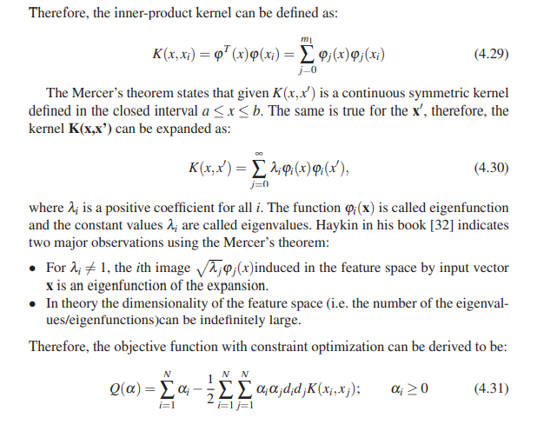

Slide 128
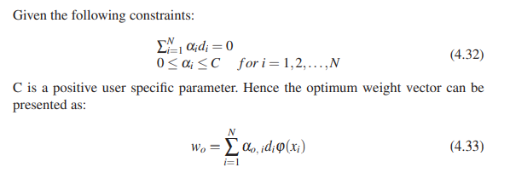

Slide 129
Support Vector Machine in Anomaly Detection
Intrusions can be detected by SVMs with higher accuracy and lower rates of false alarms. Detection results with the KDD Cup 99 data set reported in [56] show that more than 99% attacks are detected by SVM using 6 most important features. However, the authors don’t give detailed description about their experiments in their paper. Whether they use full KDD 1999 Cup data or not has not been addressed yet. Hwang et al.

Slide 130
Evolutionary Computation
There are two major evolutionary computation algorithms: genetic algorithm (GA) and genetic programming (GP) both of which can be applied for network anomaly detection. Genetic Programming is an extension of Genetic Algorithm [42] which is a general search method that uses analogies from natural selection and evolution.

Slide 131
A high-level description of GP algorithm can be divided into a number of sequential steps: 1. Create a random population of programs, or rules, using the symbolic expressions provided as the initial population.
2. Evaluate each program or rule by assigning a fitness value according to a pre defined fitness function that can measure the capability of the rule or program to solve the problem.
3. Use reproduction operator to copy existing programs into the new generation.
4. Generate the new population with crossover, mutation or other operators from a randomly chosen set of parents.
5. Repeat steps 2 onwards for the new population until a pre-defined termination criterion has been satisfied or a fixed number of generations have been completed

Slide 132
Evolutionary Computation in Anomaly Detection
In a different approach, Lu and Traore proposed a rule evolution approach based on Genetic Programming (GP) for detecting novel attacks on networks in [52]. In their framework, four genetic operators, namely reproduction, mutation, crossover and dropping condition operators, are used to evolve new rules. New rules are used to detect novel or known network attacks. Experimental results show that rules generated by GP with part of KDD 1999 Cup data set has a low false positive rat

Slide 133
Association Rules
: Given a database D of transactions where each transaction T ∈ D denotes a set of items in the database, an association rule is an implication of the form X =⇒ Y, where X is subset of D, Y is subset of D and X ∩Y = /0. The general form of the rule that relates objects to one another is shown below [30]:
X =⇒ Y [Support,Conf idence]
Formulas for the support and confidence value are listed in below: support(A =⇒ B) = P(A∪B)
con f idence(A =⇒ B) = P(B|A)
Find all frequent itemsets: By definition, each of these items will occur at least as frequently as a pre-determined minimum support count.
Generate strong association rules from the frequent itemsets: By definition, these rules must satisfy minimum support and minimum confidence.

Slide 134
The Apriori Algorithm
1. The join step: Let the itemsets to be sorted, then a set of k-candidate itemsets can be joined if the first k-1 of their items are identical. Let l1 and l2 be two itemsets. The members l1 and l2 of Lk−1 are joined if (l1[1] = l2[1])∧(l1[2] = l2[2])∧··· ∧(l1[k−1] < l2[k−1]) Then the result of joining these two will be l1[1]l1[2]...l1[k−1]l2[k−1].
2. The Prune step: Han indicates that any k-1 itemset that is not frequent can not be a subset of frequent k-itemset. Then he follows: “Hence, if any (k-1)-subset of a candidate k-itemset is not in Lk−1, then the candidate cannot be frequent either so can be removed from Ck”. Where Ck is a superset of Lk

Slide 135
Association Rules in Anomaly Detection
1999 DARPA evaluation. It uses data mining to build a customizable profile of rules of normal behavior and then classifies attacks (by name) or declares false alarms. To discover attacks in TCPdump audit trail, ADAM uses a combination of association rules, mining and classification.

Slide 136
Clustering
1. Samples are from a known number of classes. 2. The priori probability P(ωj) of each class is known. 3. Class-conditional probability densities p(x|ωj,θ) are available. 4. The values for the parameter vectors θ1,...,θc are not available. 5. There is no information about the labels for the categories

Slide 137
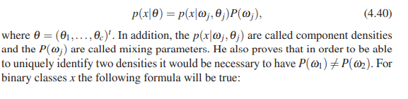

Slide 138
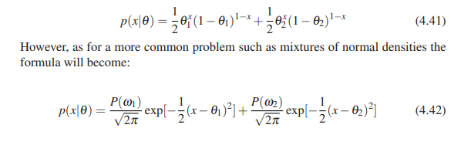

Slide 139
Hierarchical clustering
Non-hierarchical clustering
Model based clustering
Similarity based clustering
Centroid based clustering
K-Means Clustering
Y-Means Clustering

